Slide 1
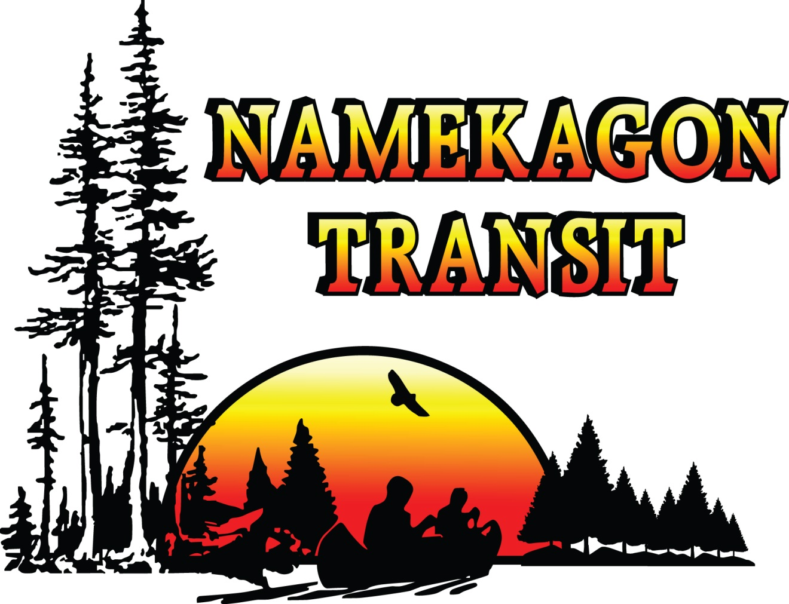
Why Use Public Transportation?

Slide 2
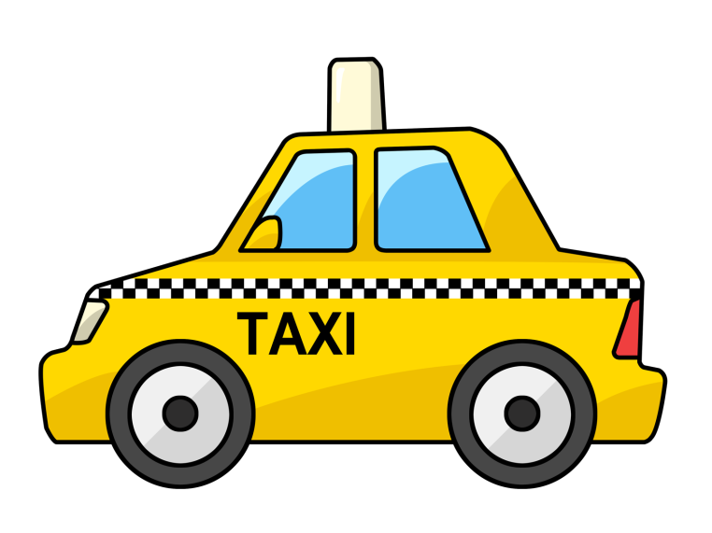
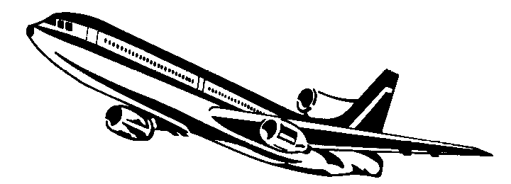
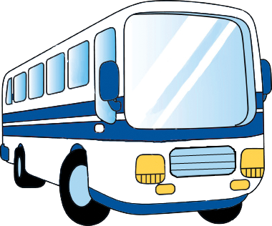
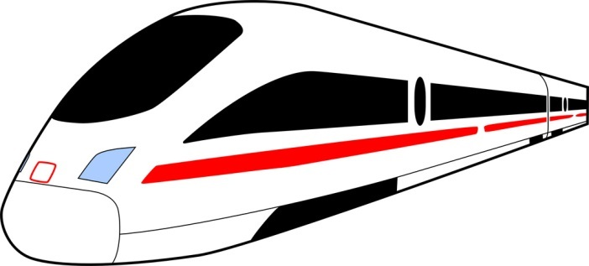
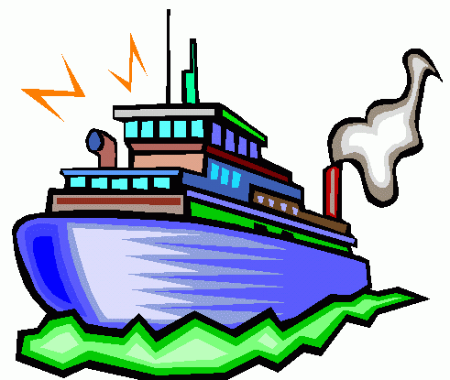
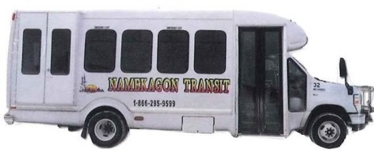
Common Modes of Public Transit
How many have you tried?

Slide 3
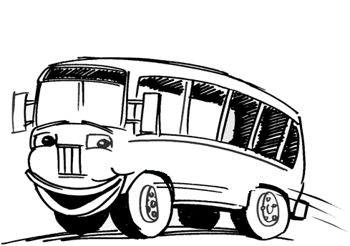
Why Use Public Transit?
Can you think of any benefits?

Slide 4
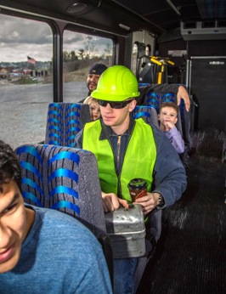
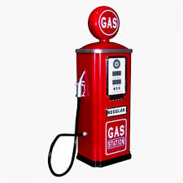
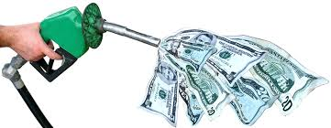
Why Use Public Transit?
Public Transportation Enhances Personal Opportunities
Public transportation gives people options to get to: work, school, friends, or doctor’s office.
Public Transportation Saves Fuel
Public transportation use in the United States saves 4.2 billion gallons of gasoline annually.
Public Transportation Reduces Carbon Footprint
Public transit use in the USA reduces carbon emissions by 37 million metric tons annually.
CO²
CO²
CO²
CO²
CO²
CO²
Public Transportation Saves Money
Using public transportation is the quickest way to beat high gas prices. Average family save $10,000 annually.
Public Transportation Is Safe
If you ride the bus, you are about 60 times safer than in an automobile in the US, according to recent finding in the Journal of Public Transportation.

Slide 5
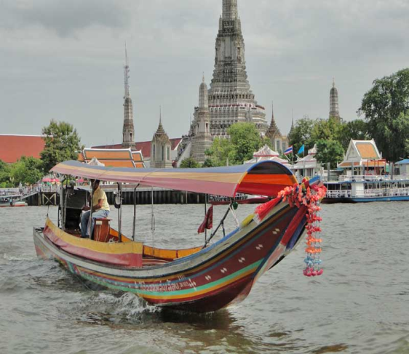
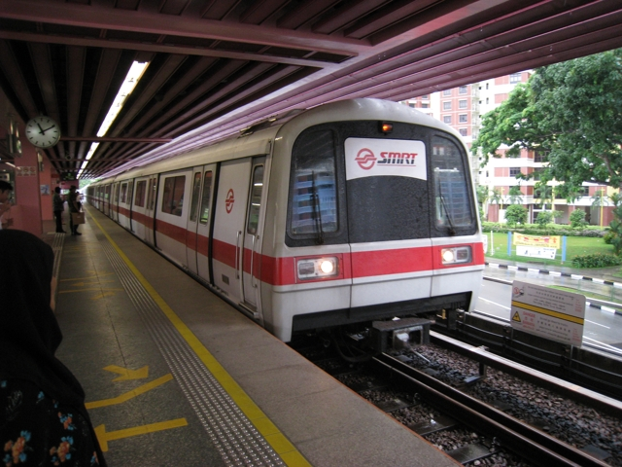
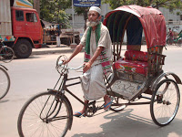
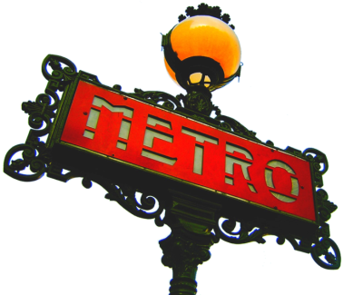
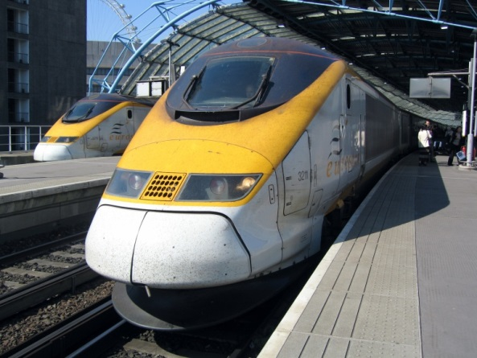
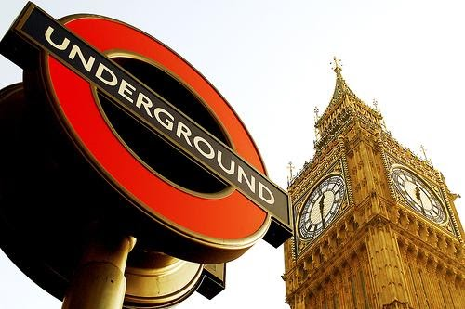
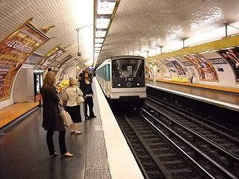
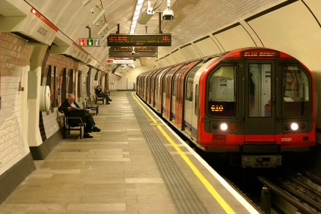
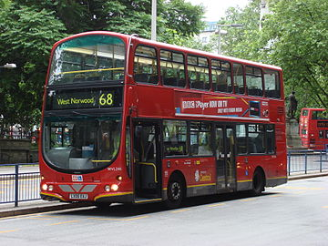
Public Transit is Global & Fun
Don’t be afraid to
try Public Transit!

Slide 6
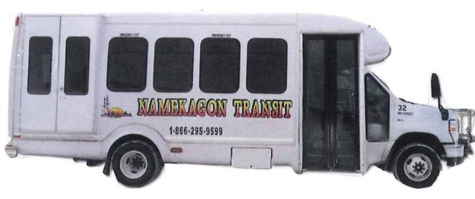
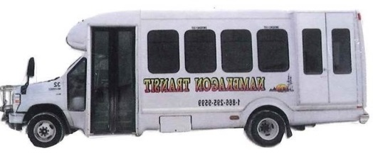
Need a ride?
Give us a call!
Toll Free: (866) 295-9599

Slide 7
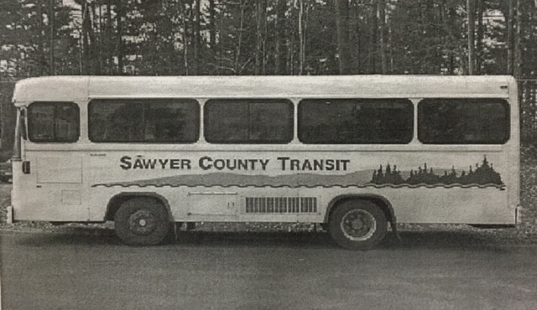
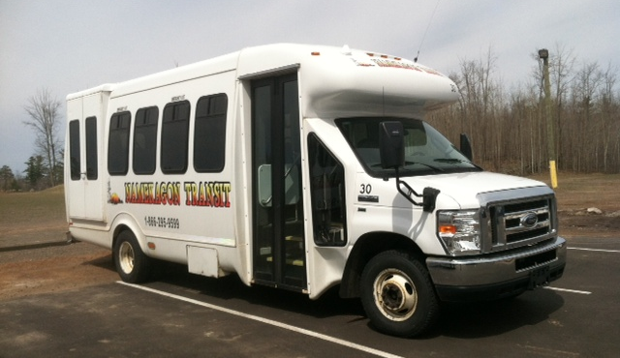
We’ve come a long way…
April 1998
Namekagon Transit as served our community for 18 years!
All 25 of our modern buses are climate controlled
and have lifts for riders with mobility devices or
those who have difficulty in climbing stairs.

Slide 8
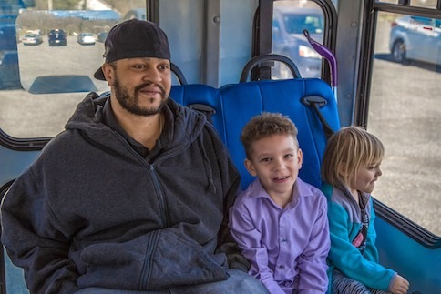
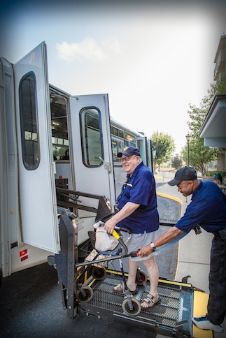
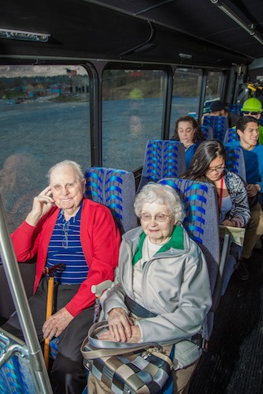
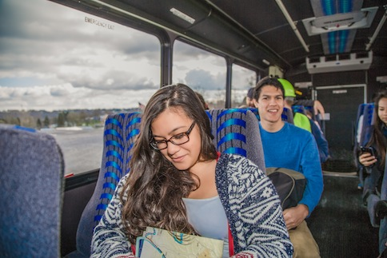
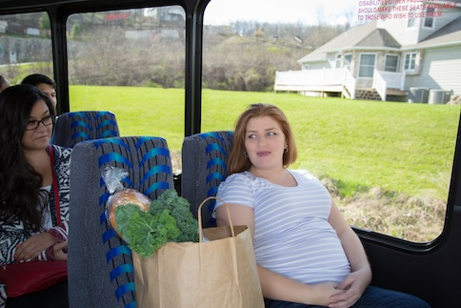
Who can ride the bus?
Anyone can ride the Namekagon Transit!
It’s the “Public Bus For All Of Us”

Slide 9
Faces of Namekagon Transit Video
Anyone can ride the Namekagon Transit!
It’s the “Public Bus For All Of Us”

Slide 10
Where can I go on the Namekagon Transit Bus?

Slide 11
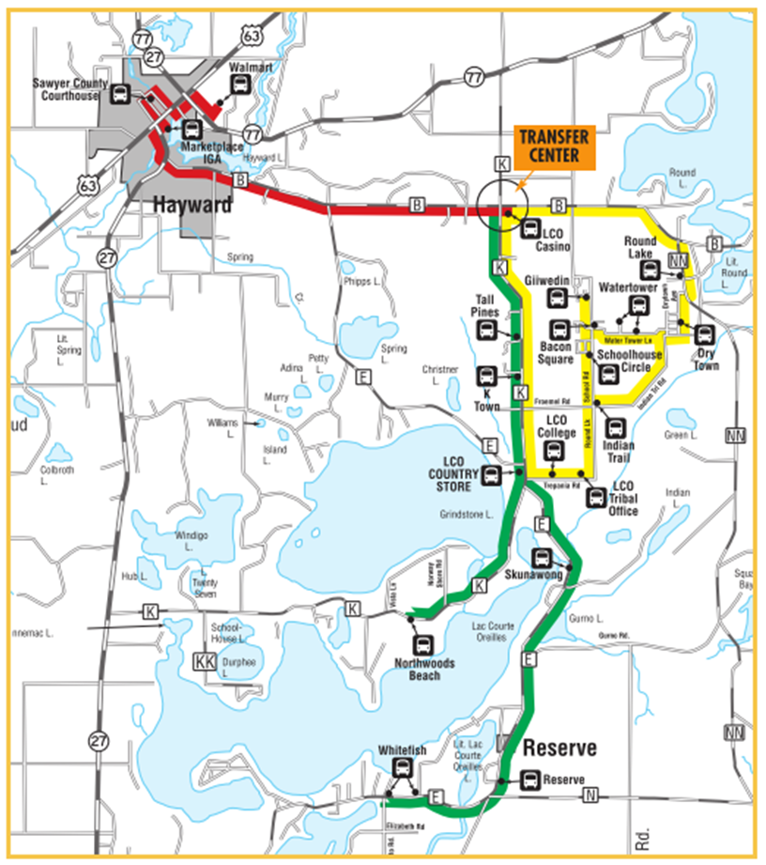
Sawyer County Deviated Fixed Routes
All three Fixed routes meet at the
LCO Casino
Flag stops can be made along the routes, provided it is a safe location for the vehicle to stop.

Slide 12
Sawyer County Deviated Fixed Routes
Buses
leave
the LCO
Casino
every hour
on the
half
of the hour!

Slide 13
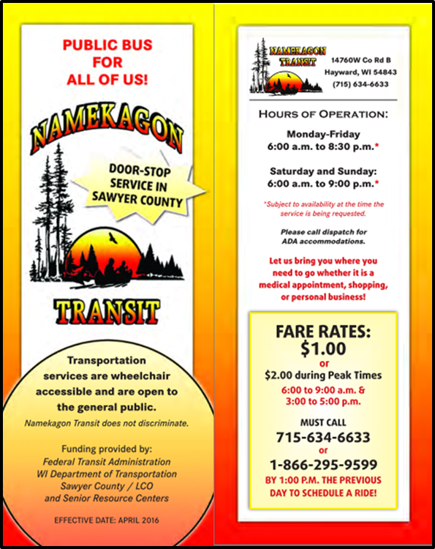
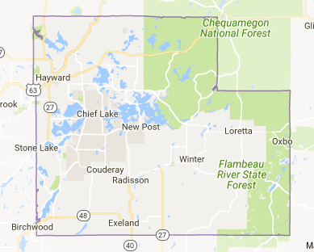
Sawyer County Door Stop Service Area
We will pick you up at your door
anywhere in Sawyer County!
MUST CALL BY 1:00 PM
THE PREVIOUS DAY
TO SCHEDULE A RIDE!

Slide 14
Additional Routes

Slide 15
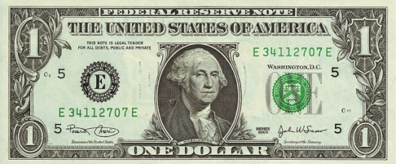
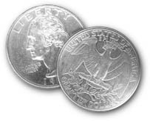
How much does it cost to ride the bus?
We accept cash or tokens.
All transfers between buses are free!
$1.00
$.50
With
Transit ID
card
Please have correct fare ready when boarding the bus. The Bus drivers are NOT able to make change.
If you have a reduced fare card, please present it to the driver in order to receive your ride at the half-price.

Slide 16
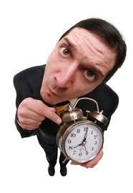
“Need To Know” Rider Information
As a new rider, you may not be familiar with bus riding procedures, so below we have noted some “need to know” rider information!
For Door Stop Service, please be ready for your pick up 10 minutes prior to your scheduled time.
Potential riders not wearing a shirt or shoes will not be allowed on the bus.
No
There is no food or beverage consumption allowed while riding on a Namekagon Transit bus.

Slide 17
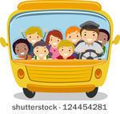
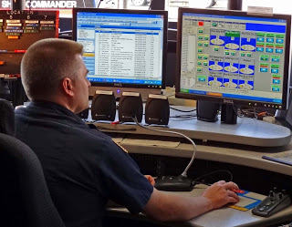
“Need To Know” Rider Information - Continued
Please know that each passenger is limited to three (3) carry-on bags/packages/items and are subject to size limitations.
In the same manner that you expect courteous and respectful treatment from our drivers, we also ask the same from the riders. Drivers are responsible for all the riders and therefore can ask that a belligerent passenger leave the bus.
Lastly, please know that in the event that you need to cancel your ride, you must call and talk to dispatch directly. Please refer to “No Show” brochure included in packet.

Slide 18
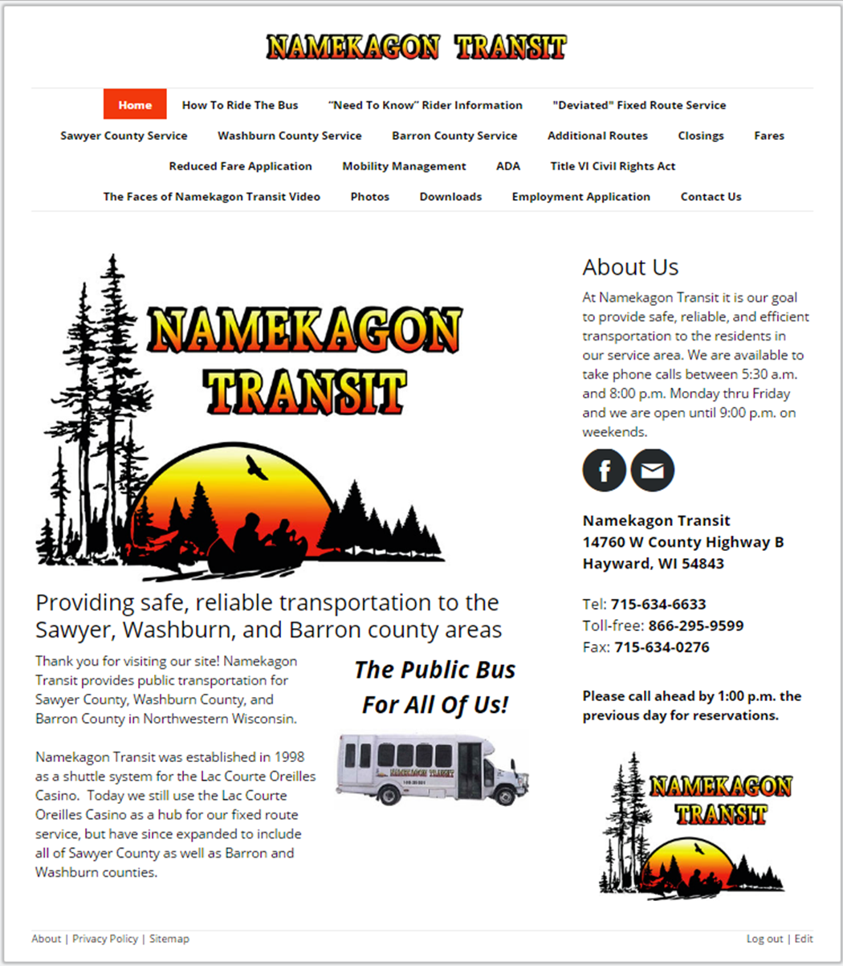
New Website: www.namekagontransit.com
Quick Link
For
Mobile Device

Slide 19
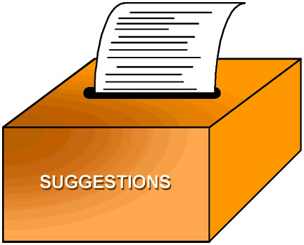
Questions? Suggestions?
Do you have any questions?
Any suggestions for us?

